Slide 1
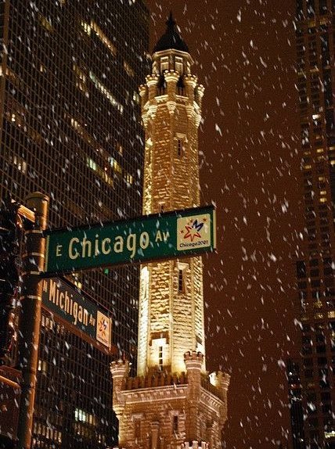
City of Chicago – Admin Reporting System
Database Design and Analysis for MScA 31012
Group 1:
Jiekai Ma
Curtis Zhuang
Karim Itani
Arpit Parihar

Slide 2

Agenda
Business Use Case
Methodology
Data Overview
Analysis
Findings and Recommendations

Slide 3
Executive Summary
Background
The Proposal
Analysis and Findings
Recommendations
Chicago is a dynamic city; patterns in crime, ordinance violations and environmental hazard complaints change rapidly.
To effectively tackle current challenges and prepare for the future, a database to load, store, extract, and use data efficiently needs to be set up
Create a system to support the decision-making process in resource and infrastructure planning, police patrol schedules and reinvestments into neighborhoods
Functionality includes ETL process from raw data, cloud relational database for storage and access and connections to BI and visualization tools
Crime has very strong correlation with temperature; crime rates plummet in winter months
Percent of arrests made goes up in winter quarter from 21% to 24%
Percent of arrests made for narcotics related crimes nears 100%, which it hovers around ~17% for other crime types
40% of the zip codes are affected by 80% of the crime
Police patrolling can be reduced in peak winter months
Focus can be diverted from possession related narcotics crimes and redirected towards other violent crimes
Investments need to be made into neighborhoods with poor living conditions like Englewood
Administrative work should be prioritized over field work for ordinance violations in winters

Slide 4

Part 1
Business Use Case

Slide 5
Business Case
Methodology
Data Overview
Analysis
Findings and Recommendations
Business Use Case
Use Case 1
Use Case 2
Use Case 3
The system can be used by city police department and administration officials to plan patrol schedules by identifying crime patterns over time and variance with weather and location
Ordinance violations and repairs can be forecast and planned proactively using insights and patterns from the system to avoid reactive repairs in untoward weather conditions, and unnecessary costs
Issues related to environmental factors can be pinpointed and resolved using the system. Construction planning can include preventive actions against potential environmental problems

Slide 6
Part 2
Methodology

Slide 7






Business Case
Methodology
Data Overview
Analysis
Findings and Recommendations
Project Outline
Raw Data
Intermediate Processing
RDBMS Storage
BI and Visualizations
Daily Weather Data
Day level weather summaries
Source - NOAA
Datasets imported from csv in R to filter them from 2014 – 2019 and recoding “NA” to “\\N” for MySQL ingestion
Crime Data
Reported crime data
Source - City of Chicago
MySQL 8.0 hosted on Google Cloud Platform for data storage, manipulation, availability and collaboration
Base tables for crime, weather, environment complaints and ordinance violations
Views created for analysis tables and visualizations
Data standardization done in OpenRefine to combine similar categories and reformat dates
Tableau dashboards for:
Observing trends across dimensions
BI and deep dives
Violations Data
Ordinance violations data
Source - City of Chicago
Environment Complaints Data
Complaints made for environment issues
Source - City of Chicago
Coordinates reverse geocoded in python to obtain zip codes for the location table

Slide 8
Business Case
Methodology
Data Overview
Analysis
Findings and Recommendations
ETL Overview
Staging database schema created for raw dataset. Staging tables to be truncated and replaced with raw data (csv) files.
Daily safety records of crime, violation, and complaint activity. Reference files for locations required to properly link the datasets. Daily, historical weather information.
Staging DB
Data Files
SQL scripts created to read from the staging schema. Will transform and transfer new records into the production database schema. Additional processing via Python Scripts required to update production database schema with information based on data and geography file
Processing Tables
Normalized relational database containing daily public safety (crime, violation, complaint), location and weather information.
Production DB Schema
Zip Codes, Neighborhoods and Community Areas shape files required for reference information in production database schema
Geography Files

Slide 9
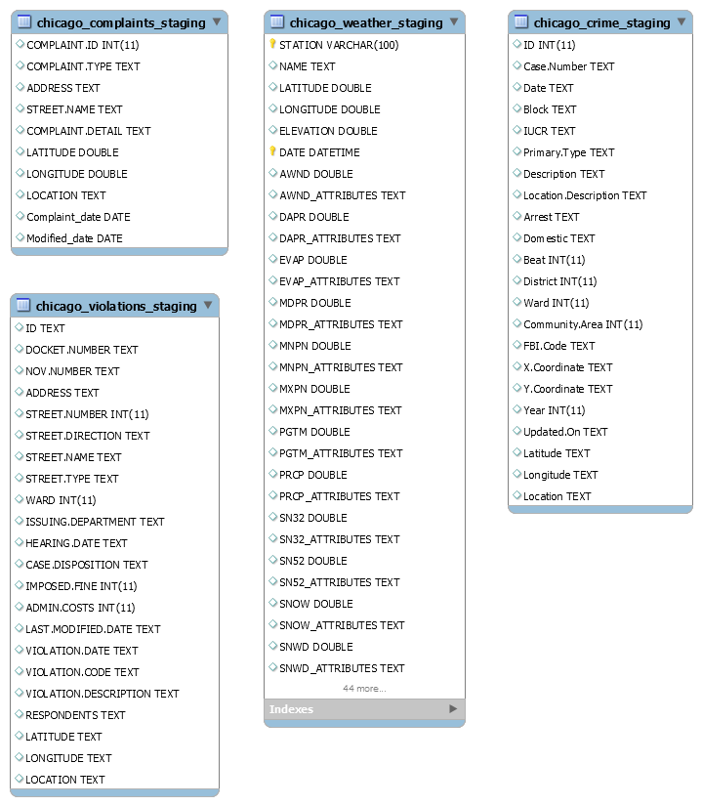
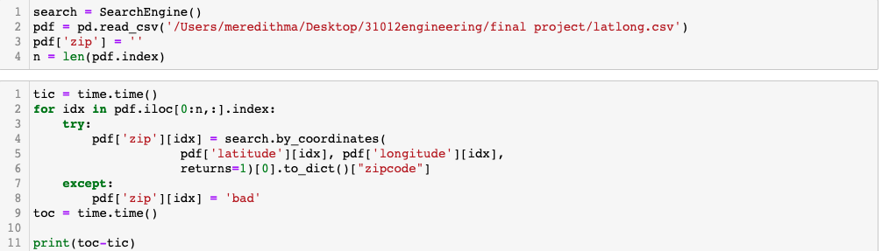
Business Case
Methodology
Data Overview
Analysis
Findings and Recommendations
Raw Data and Staging Tables
Complaints, Crime, Weather, Violations:
CSVs filtered, cleaned and standardized using OpenRefine and R
Cleaned tables imported using SQL scripts into staging tables in local MySQL server, and database migrated to MySQL on GCP
Location:
Used Python Uszipcode Library to get zip codes
Imported into Staging Schema in MySQL
ER Model

Slide 10
Business Case
Methodology
Data Overview
Analysis
Findings and Recommendations
Design Considerations
Database Design Factors
Business
Database intended to be used by city officials; the user base is moderate in size
Meant for usage primarily within Chicago, so widespread availability is not a consideration
Speed
The type of the project database is OLTP
The model is normalized in 3NF to assure high speed and low storage space consumption
Security
Separate table for separate entities to keep data secure; updating one table won't influence another
Restrict data type and set auto-increment primary key to avoid data redundancy
Scalability
More records can be added to separate tables vertically
Changes in data are reflected in individual tables, and don't have to made multiple times

Slide 11
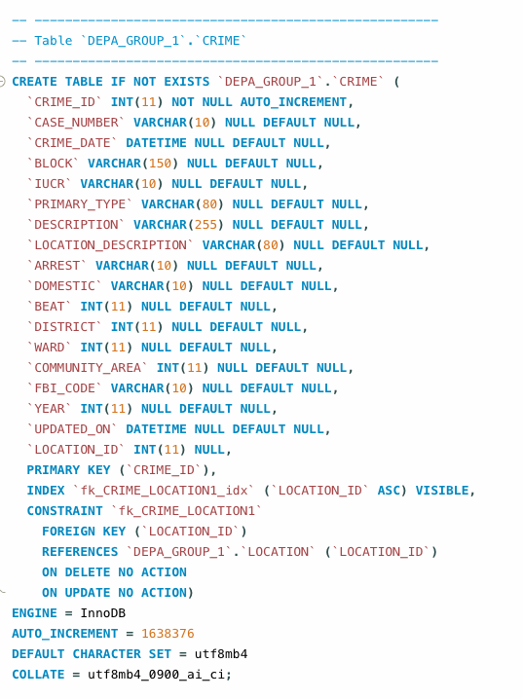
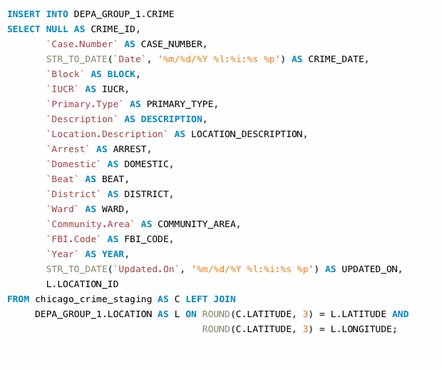
DDL and DML Queries for Data Processing
Business Case
Methodology
Data Overview
Analysis
Findings and Recommendations
DML (Part)
DDL (Part)

Slide 12
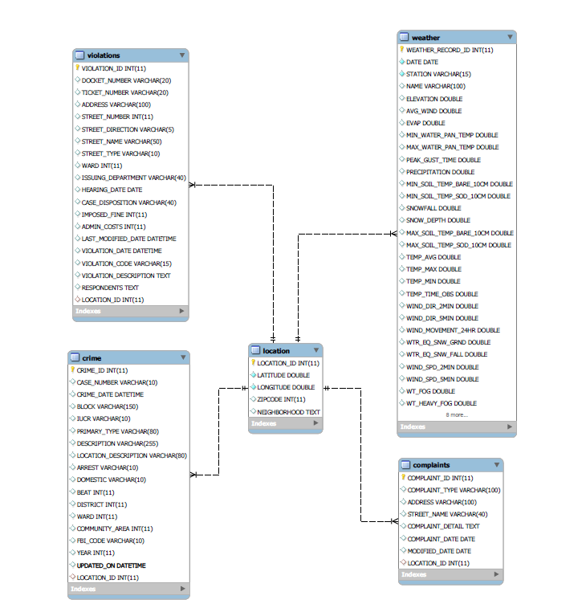
Production Database
Business Case
Methodology
Data Overview
Analysis
Findings and Recommendations
Weather:
Daily weather records from 2014 to 2019 in every neighborhood of Chicago
Crime:
Crime case records from 2014 to 2019 in Chicago Area
Violation:
Violation case records from 2014 to 2019 in Chicago Area
Complaints:
Environment_compaints case records from 2014 to 2019 in Chicago Area
EER Model

Slide 13
Part 3
Data Overview

Slide 14
Business Case
Methodology
Data Overview
Analysis
Findings and Recommendations
Crime Data Snapshot
Year
Crime
364,719
1,606,700
2015
- 4.03%
2016
+ 1.89%
2017
- 0.28%
Arrests
22.7%
Total Crime Records
2018
- 0.17%
2019
- 2.94%
Top Community Areas
Standout Events
60624 – 92,655
60619 – 77,766
60621 – 61,586
60620 – 61,519
60644 – 53,524
Most Crime
Least Crime
40% of the community areas are affected by 80% of all the crime in Chicago
Day – 2015-01-01 (1,216)
Month – July 2014 (26,560)
Year – 2014 (275,551)
Day – 2019-01-30 (341)
Month – Feb 2015 (16,383)
Year – 2019 (260,344)

Slide 15

Business Case
Methodology
Data Overview
Analysis
Findings and Recommendations
Violations Data Snapshot
Year
Violations
238,112
2015
13.24%
$ 6,138,558
2016
-24.5%
2017
-7.14%
Total Violation Records
2018
3.4%
Total Admin Costs
2019
17.2%
Top Zip Codes
Standout Events
60619 – 14,456
60649 – 12,298
60620 – 11,707
60621 – 11,390
60637– 10,923
32% of the zip codes have 70% of all violations in Chicago
Most Violations
Least Violations
Day – 2018-01-15(709)
Month – April 2014(4896)
Year – 2015 (47852)
Day – 2019-06-22 (1)
Month – Nov (1413)
Year – 2019 (33130)

Slide 16

Business Case
Methodology
Data Overview
Analysis
Findings and Recommendations
Complaints Data Snapshot
Year
Complaints
6,577
2015
-22.58%
17 days
2016
14.47%
2017
9.32%
Average Resolution Time
Total complaint records
2018
-3.48%
2019
36.88%
Top Zip Codes
Standout Events
60614 – 512
60617 – 401
60647 – 256
60610 – 212
60618 – 203
47% of the zip codes have 90% of all complaints in Chicago
Most Complaints
Least Complaints
Day – 2014-05-30 (25)
Month – September 2019(185)
Year – 2019 (1440)
Day – 2015-04-29 (1)
Month – February 2015 (41)
Year – 2015 (871)

Slide 17

Business Case
Methodology
Data Overview
Analysis
Findings and Recommendations
Weather Data Snapshot
49.7
Average Temperature
in 2019
Year
Avg. Temp
233,054
2015
5.3%
2016
4.1%
Total Weather Records
2017
0.3%
2018
-3.0%
2019
-2.5%
Weather Stations
Standout Events
Total – 242
Chicago Area - 20
Coldest
Warmest
Day – 2019-01-30 (-15 F)
Month – Feb 2015 (15.85 F)
Year – 2014 (47.88 F)
Day – 2018-06-18 (87 F)
Month – July 2019 (76.9 F)
Year – 2017 (52.7 F)

Slide 18

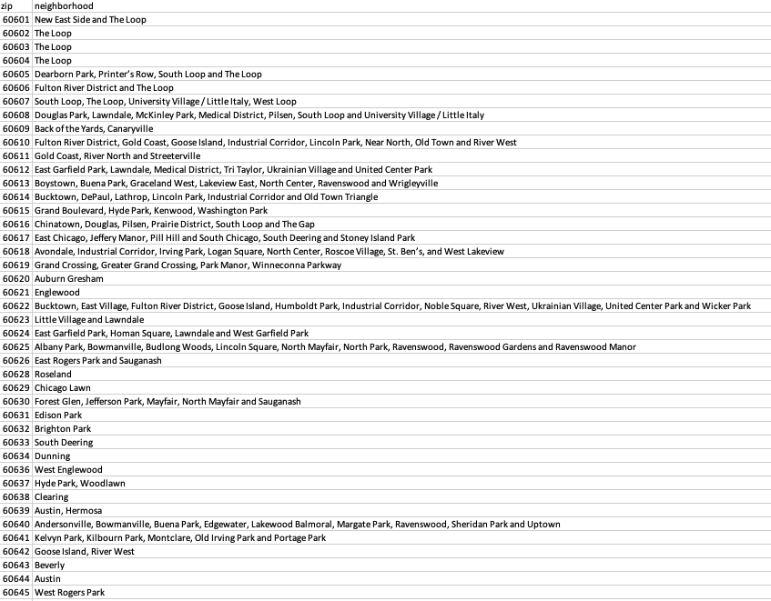

Business Case
Methodology
Data Overview
Analysis
Findings and Recommendations
Location Data Snapshot
188
Total Chicago Area Zipcodes
63
Chicago City Zipcodes
Neighborhoods (Part)

Slide 19
Part 4
Analysis

Slide 20
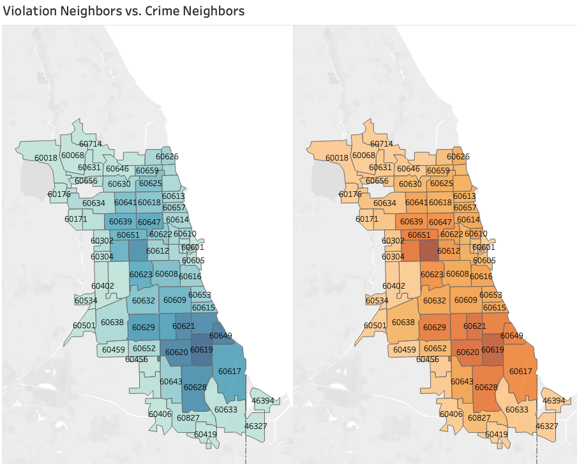
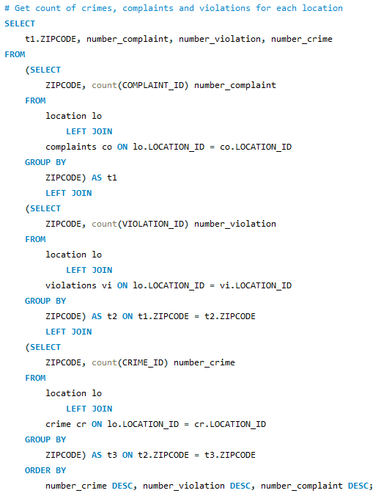
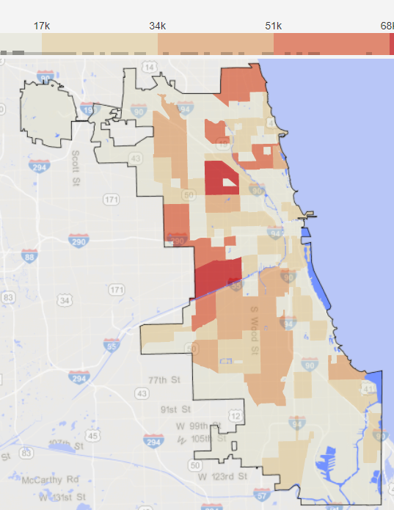
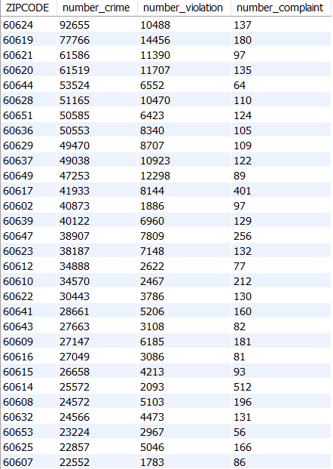
Business Case
Methodology
Data Overview
Analysis
Findings and Recommendations
Zip Codes with High Crime Have High Number of Violations, while Environmental Complaints are Unrelated
Crimes and violations is not a direct result of population
Drugs can be a factor which we will explore later

Slide 21
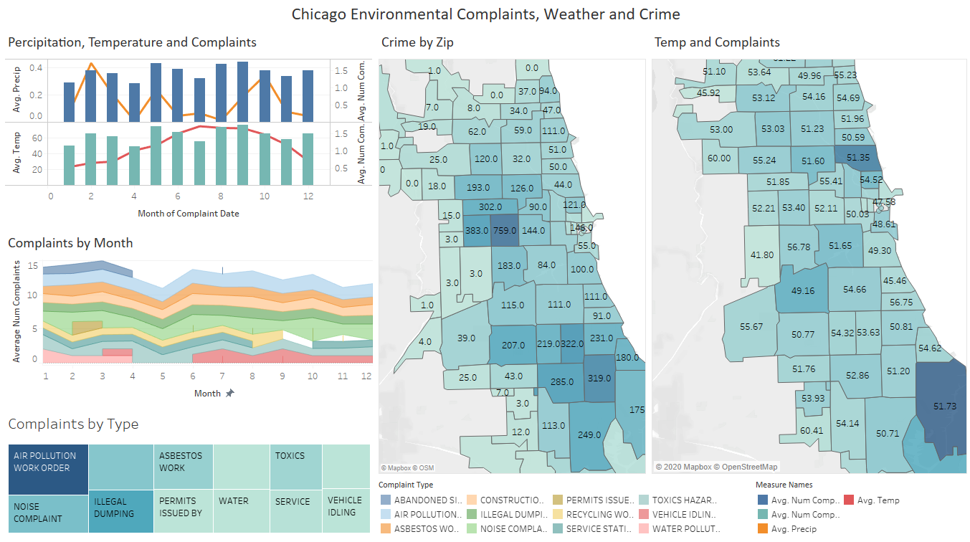
Business Case
Methodology
Data Overview
Analysis
Findings and Recommendations
Environmental Complaints are Loosely Related With Temperature While Complaint Type is Not
Complaints and crimes has different distributions
Complaints are related to temperature but not percipitation
Complaint type does not seem to differ much

Slide 22
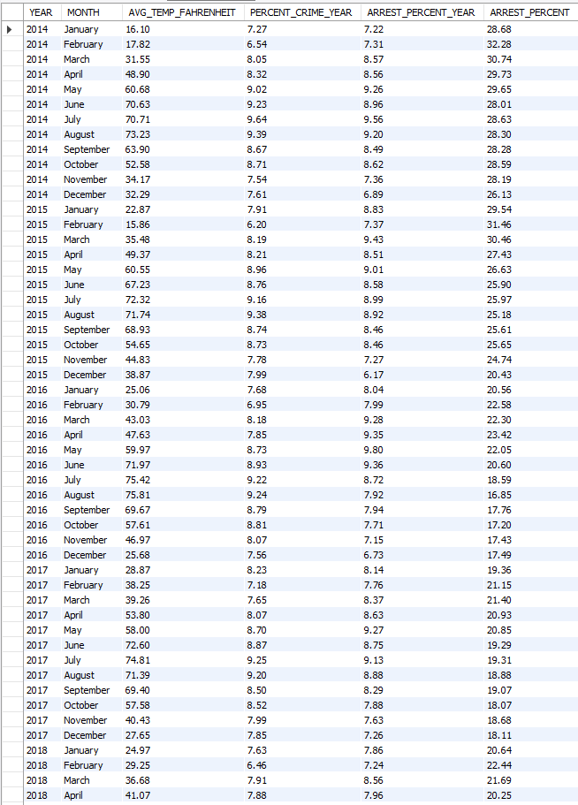
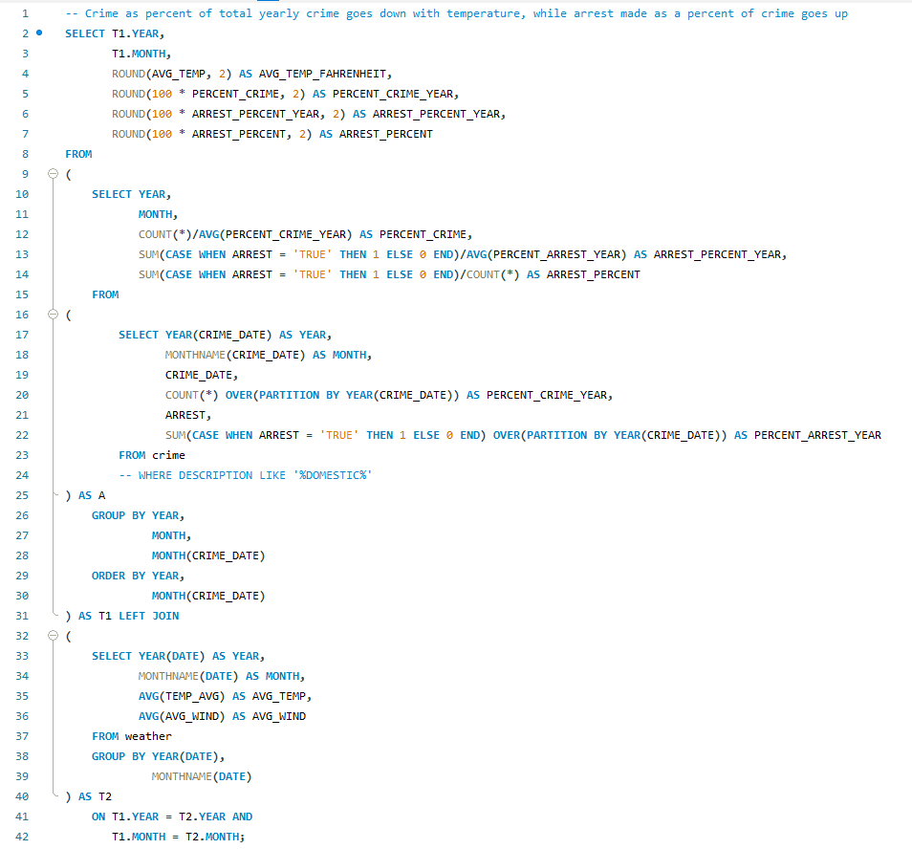
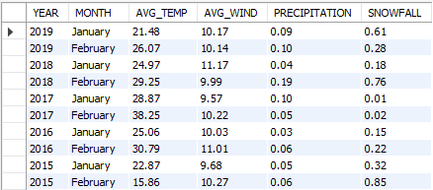
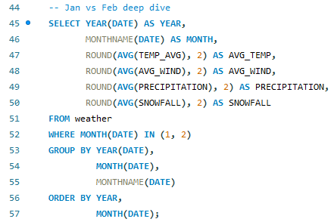
Crime Goes Down as Temperature Goes Down; Winter Months See Significantly Less Crime
Business Case
Methodology
Data Overview
Analysis
Findings and Recommendations
Months with lower temperatures account for a lower share of yearly crime (6-7%) than months with higher temperatures (8-10%)
Although January usually sees the lowest temperatures in a calendar year, the lowest crime rates often correspond to February
This is because February generally has more inhospitable weather conditions like wind, snow and rain despite higher temperatures than January
Arrest % goes up in winter months as CPD isn’t overwhelmed with the volume of crime

Slide 23
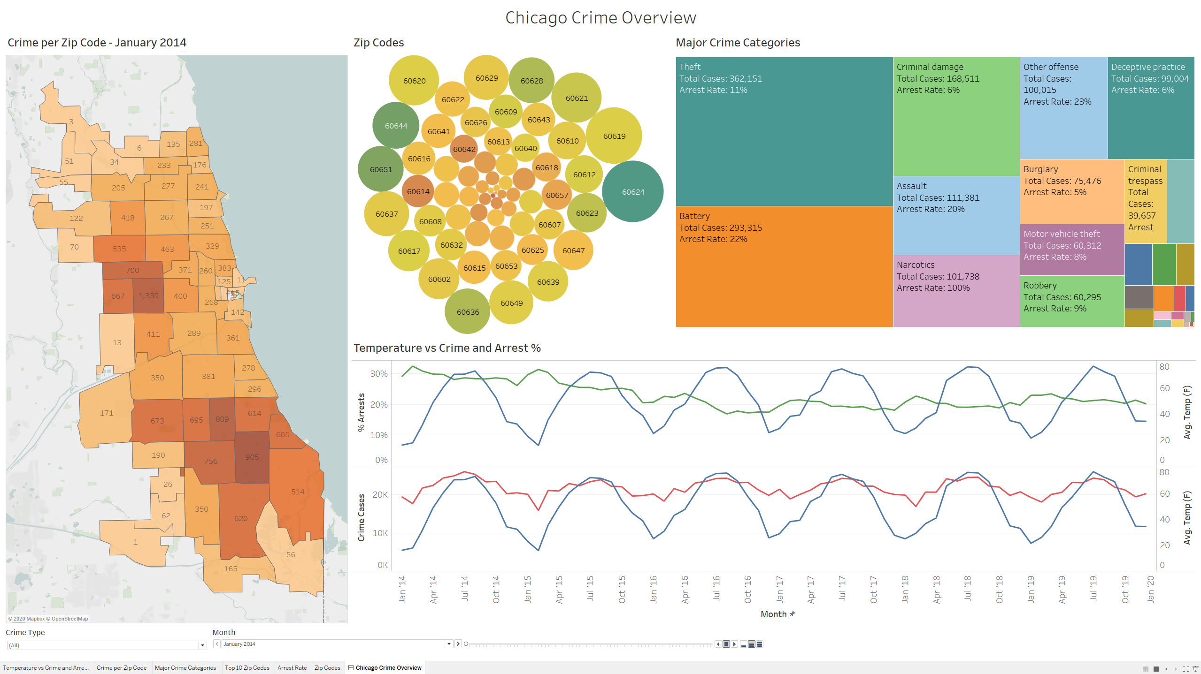
Business Case
Methodology
Data Overview
Analysis
Findings and Recommendations
Chicago Crime Overview Dashboard

Slide 24
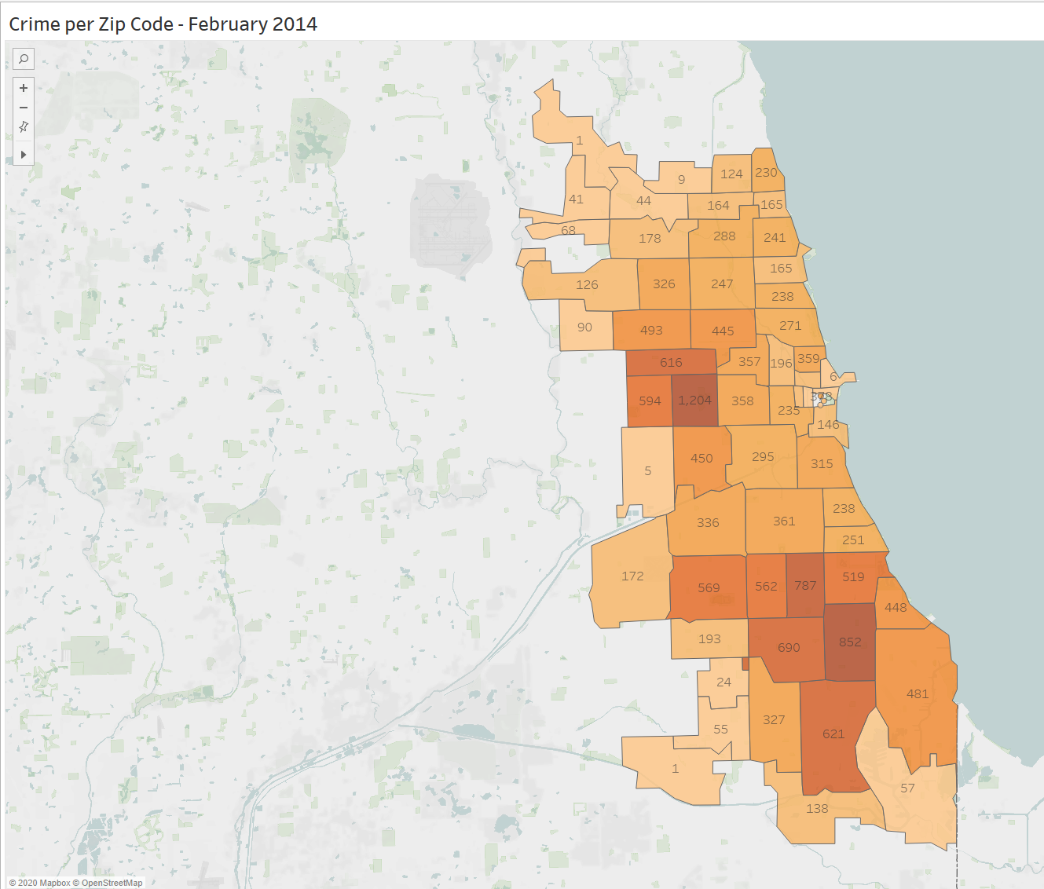
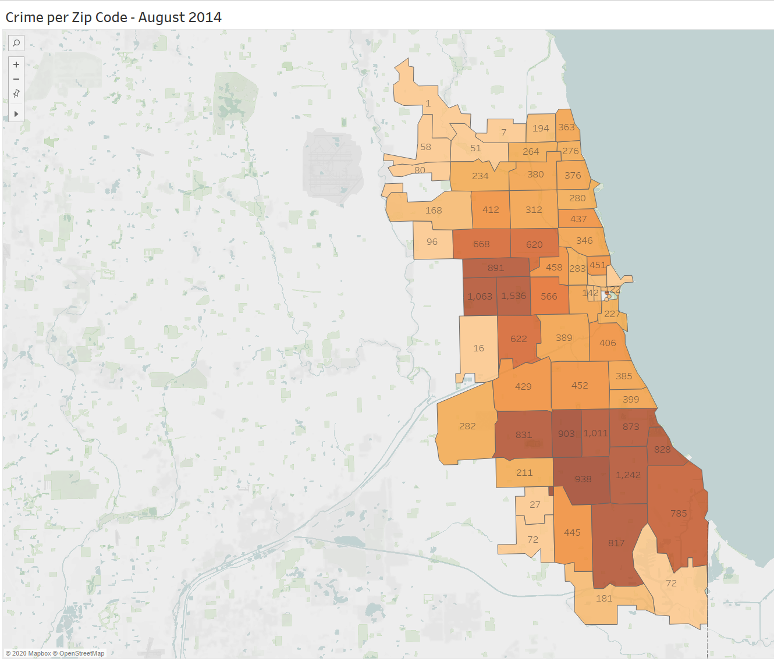
Crime goes down as temperature goes down, winter months see significantly less crime
Business Case
Methodology
Data Overview
Analysis
Findings and Recommendations
16 F
73 F
Eye test confirms that February 2014 (avg. Temp - 16 F) has a lot less crime than August (avg. Temp - 73 F)
Change in crime volume isn't much in high crime zip codes, but in months with higher temperatures, crime starts spreading to neighboring zip codes

Slide 25
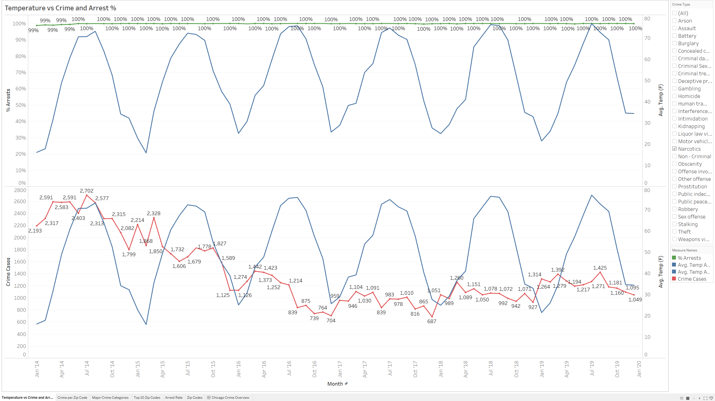
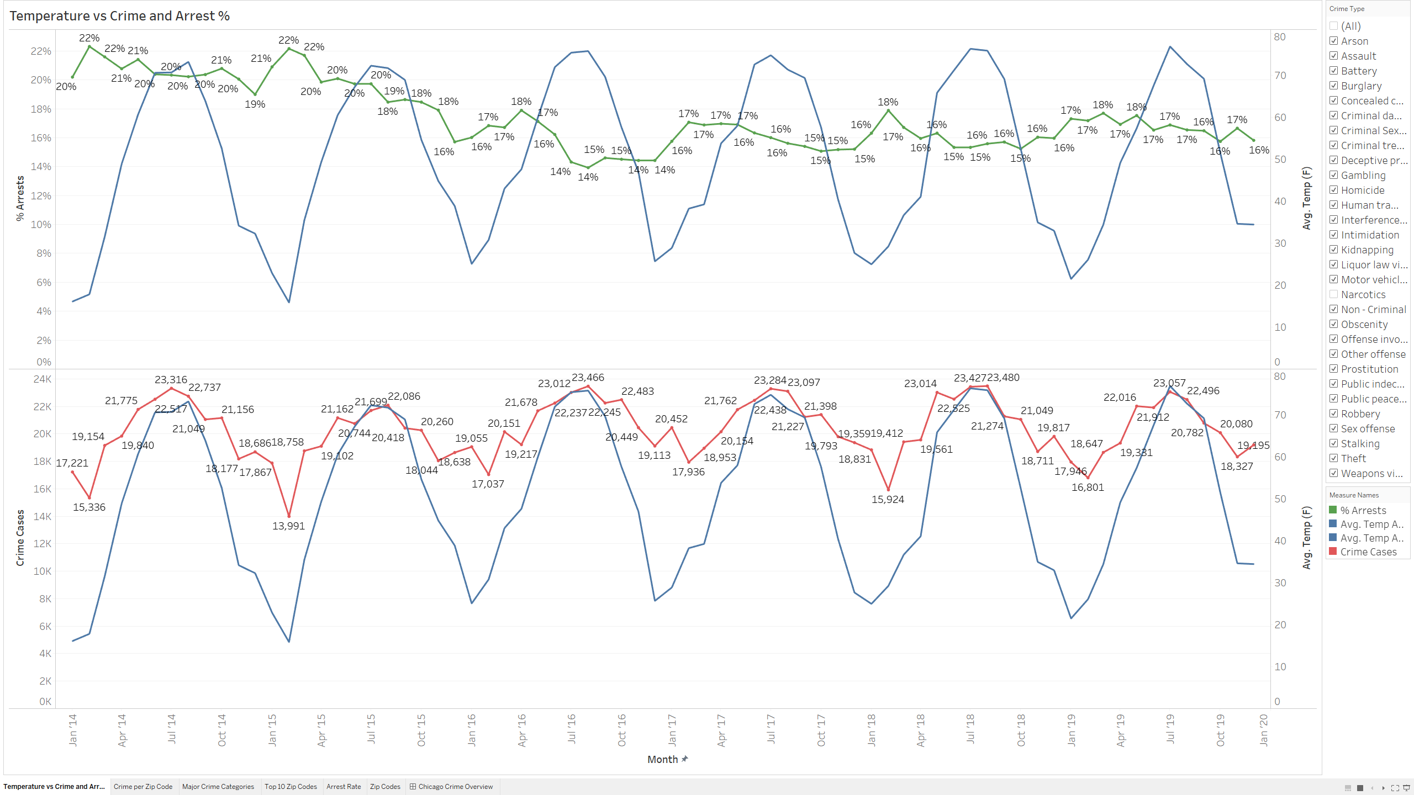
Narcotics Crime Has An Arrest Rate of 100%, While Arrest Rate for Crime in Other Categories is 17%
Business Case
Methodology
Data Overview
Analysis
Findings and Recommendations
Arrest rate hovers around 100% for narcotics, but it's low for other crime categories (16% – 17%)
With marijuana legalization, efforts can be redirected away from narcotics towards other crime types

Slide 26
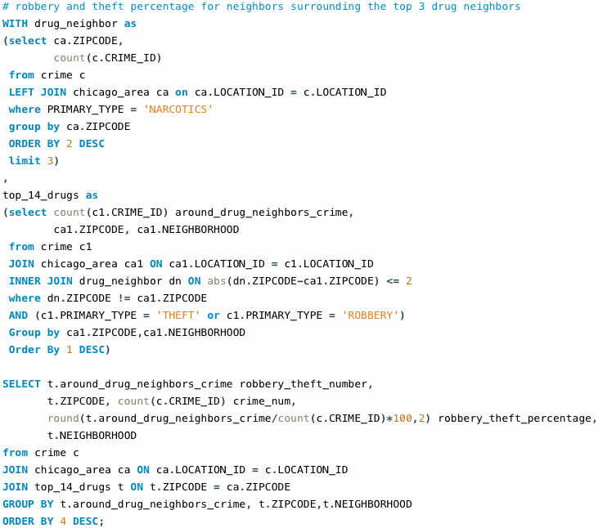
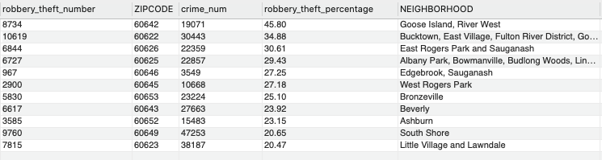
Zip Codes with High Drug Crime Cases and Their Surroundings Have High Theft and Robbery Rate.
Business Case
Methodology
Data Overview
Analysis
Findings and Recommendations

Slide 27
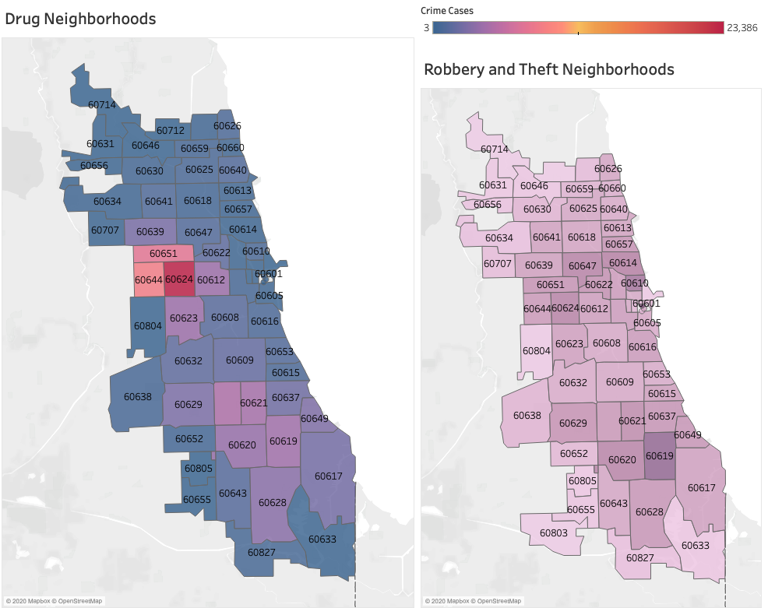
Business Case
Methodology
Data Overview
Analysis
Findings and Recommendations

Slide 28
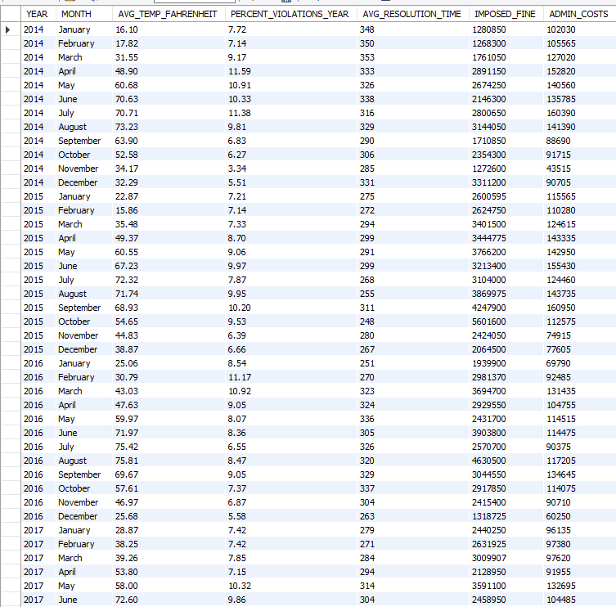
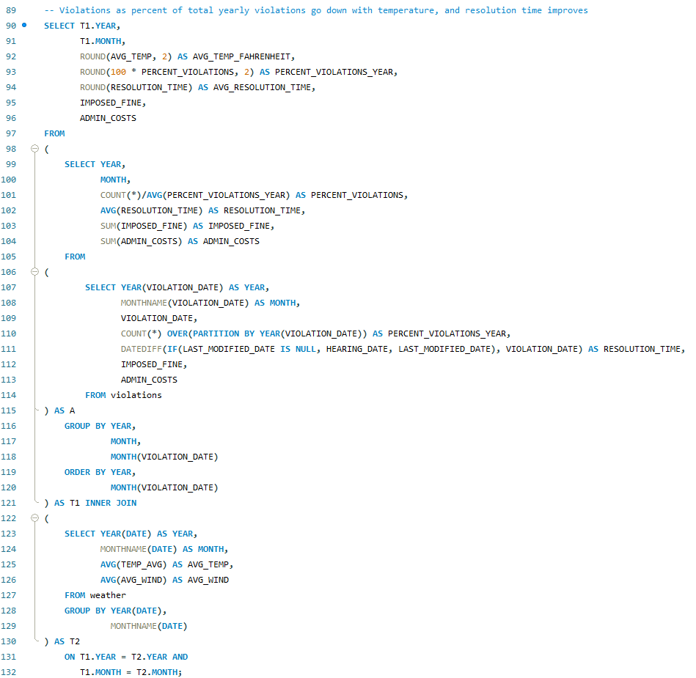
Number of Violations Go Down With Temperature, But Resolution Time Doesn’t Follow It Closely
Business Case
Methodology
Data Overview
Analysis
Findings and Recommendations
Months with lower temperatures account for a lower share of yearly violations (5-8%) than months with higher temperatures (6-11%)
Average resolution time doesn't have good correlation with temperature, which presents an opportunity for improvement

Slide 29
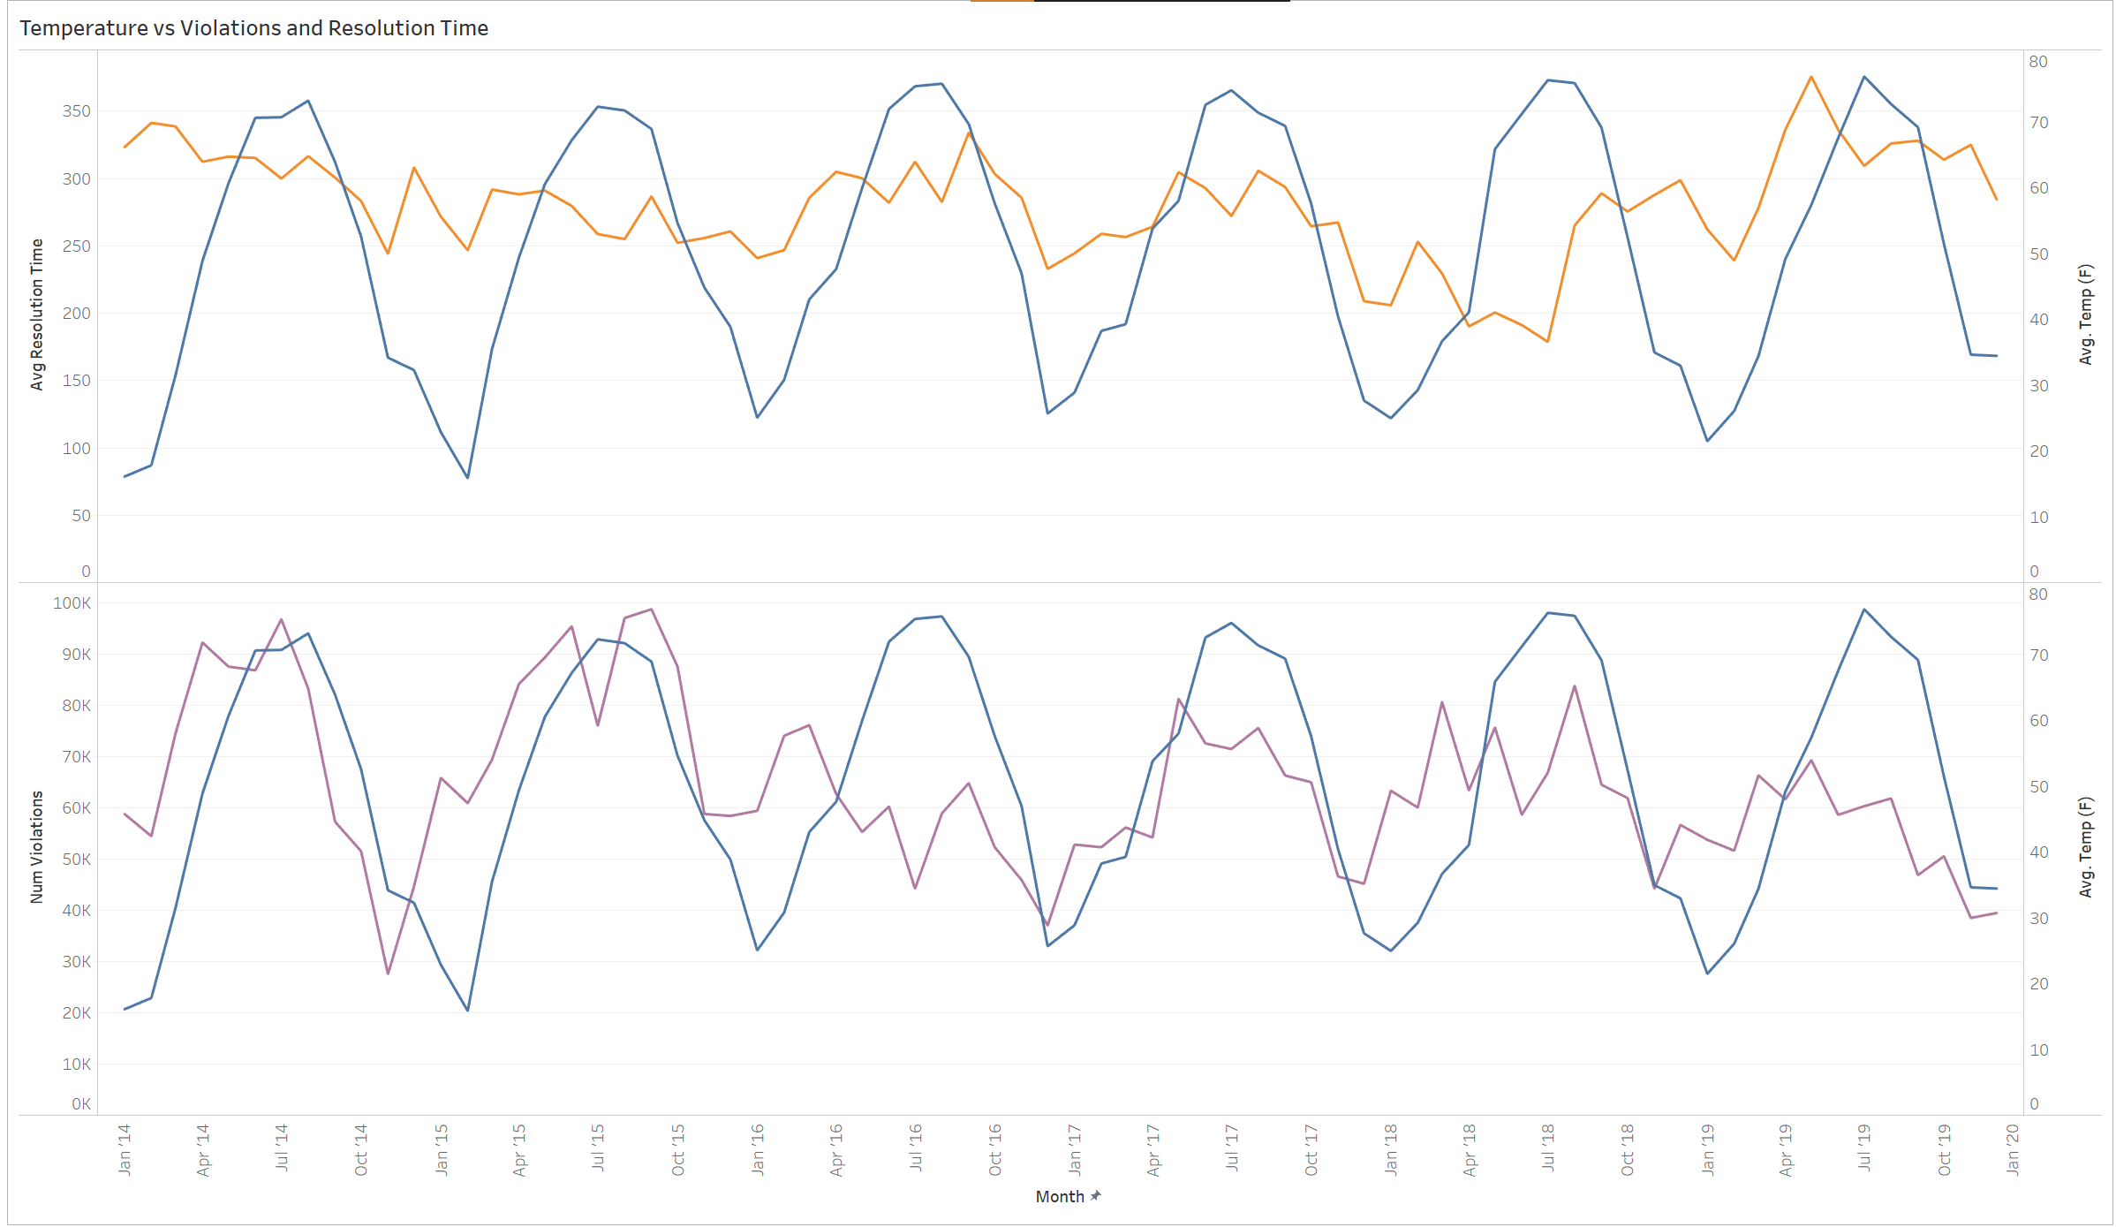
Number of Violations Go Down With Temperature, But Resolution Time Doesn’t Follow It Closely
Business Case
Data Overview
Analysis
Findings and Recommendations
Methodology
Business Finding
Field staff can be assigned to administrative work in winter months as there's fewer violations and they can help in clearing the backlog of previous complaints

Slide 30
Part 5
Findings and
Recommendations

Slide 31
Business Case
Methodology
Data Overview
Analysis
Findings and Recommendations
Recommendations
Recommendation 1
Recommendation 2
As crime goes down with temperature, Police patrolling can be reduced in winter months and increased in summer months for more and efficient distribution
With marijuana legalization, focus can be diverted from possession narcotics crimes, and redirected towards other more violent/serious crimes where arrest rate is significantly lower
Recommendation 3
Recommendation 4
There's a clear disparity in living conditions between neighborhoods, we recommend the city to invest money and effort into high crime, high violations areas around West and South Chicago areas like Garfield Park and Englewood to better the living conditions there
There's a pattern between number of violations and temperature, but not with resolution time. We recommend the city to reallocate resources from field work to administrative work during winter times to clear previous backlog and resolve cases faster
12/10/20

Slide 32
Business Case
Data Overview
Analysis
Findings and Recommendations
Analysis
Business Finding
Business Case
Methodology
Data Overview
Findings and Recommendations
Methodology
Next Steps
Collect Precise Weather Data
Build Predictive Models
Add Additional Dimensions
With better weather reporting coverage, more relationships and patterns can be studied
Crime, violations and complaints can be forecast using the data collected
Data around unemployment, income, education and mental health can be added to the model for better insights
Linear models for crime with temperature as predictor or Holt-Winters' to forecast other metrics can be explored
More variables can act as proxy for standard of living and can provide more visibility on crime and other KPIs
Precise weather data can help eliminate systematic errors
Collaborate with weather stations across the city to collect richer data
Machine learning classifiers for predictive maintenance using violations data can provide a lot of value
Community areas can be geocoded and added to the DB to make the analyses and reporting more relatable
12/10/20

Slide 33

THANK YOU

